Slide 1

AASC Lesson 1.2: Vulnerable Points and Vulnerable Areas
Notes:
Find guidance inserted in the note section of each slide.

Slide 2

Overview
2.4.1 Definitions
2.4.2 Personal Threat Assessment - CAGES
2.4.3 Types of VPs
2.4.4 Examples of VPs and VAs

Slide 3
Terminal Learning Objectives
At the end of this module, the participants will be able to describe and recognize Vulnerable Points and Vulnerable Areas as well as apply the use of CAGES to dynamically assess vulnerable points.

Slide 4
2.4.1 Definitions of VPs and VAs

Slide 5
Definition
VP’s and VA’s
A Vulnerable Point (VP) is a specific point where it is particularly advantageous to target friendly forces with an IED and/or Small Arms Light Weapons (SALW), ambush or both. They are typically characterized by prominent or restrictive feature
Vulnerable Areas (VA) are those areas where the ground/terrain lends itself to IED or SALW attack.
Notes:
A Vulnerable Point (VP) is a specific point where it is particularly advantageous to target friendly forces with an IED and/or Small Arms Light Weapons (SALW), ambush or both. They are typically characterized by prominent or restrictive feature, as e.g., limitation of speed, movement, or visibility due to terrain, or choke point on the ground. They could as well be based on patterns established by Peacekeepers, using the same entry to camps, patrolling the same roads and villages, using the same lookout, etc.
Vulnerable Areas (VA) are those areas where the ground lends itself to IED or SALW attack.

Slide 6
Definition
The two most important characteristics that help describe VPs and VAs are:
Canalisation – an area or point where we can be predicted to be.
Slow down or stop – a area or point where we will spend longer than usual.
IEDs will be placed in areas where they are most likely to be successful known as VP and VA locations
6
Notes:
While there are various locations that are considered to be VPs and VAs, the two most important characteristics are locations where a target is canalised into a particular route of location and / or forced to slow down or stop.
Canalisation – allows an aggressor know the path a target will travel.
Slow down or stop – allows an aggressor initiate an IED at the optimal moment to maximise target effects

Slide 7
2.4.2 Personal Threat Assessment - CAGES

Slide 8
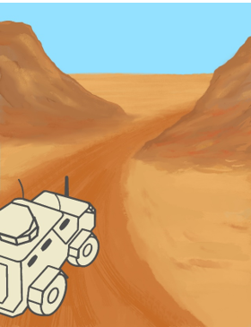
Personal Threat Assessment
IEDs are not placed at random
They are placed at points which advantage the adversary
These are known as vulnerable points.
The use of a personal threat assessment can help to alert that you might be approaching a vulnerable point.
8
Notes:
Despite being cheap and easy to manufacture, IEDs are still a limited resource to an adversary. As such, they are not deployed randomly everywhere. They are placed by an insurgent in a locations which afford an advantage to the adversary and where they IED can have the best chance of achieving its effect. These locations at which an IED can be effectively employed are known as Vulnerable Points. A personal threat assessment can be used by the soldier on the ground to help them identify Vulnerable Points and alert them to the risk of an IED attack.

Slide 9
Personal Threat Assessment
Channelling
Aiming Markers
Ground (Terrain)
Environment
Setting Patterns
9
Notes:
There are five key indicators to continually look out for by proactively looking at the surrounding when operating in an IED threat environment. CAGES is a tool that can be used for IED indicators:
Channelled
Aiming marker
Ground
Environment
Setting Patterns
This is a tool that taught on the EHAT course. Like GSA, this is a skill that should be held by everyone who deploys, regardless of rank.

Slide 10
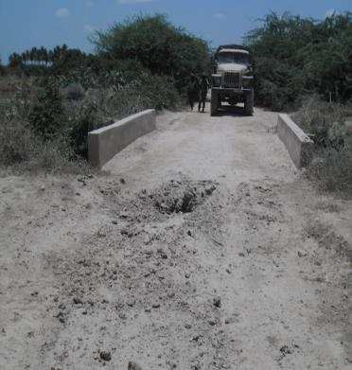
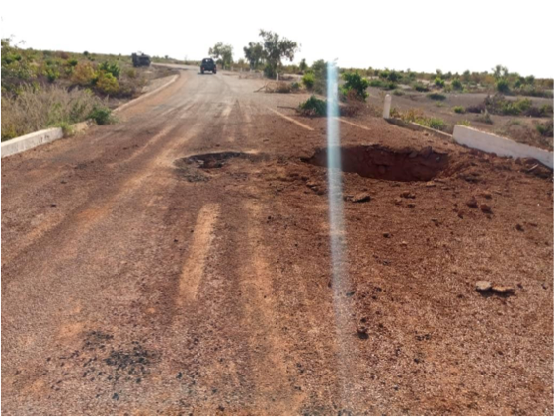

Personal Threat Assessment – Channelling
10
Notes:
While operating in an IED threat environment, it’s important to constantly assess whether the ground is channeling you, either by natural or manmade obstacles or features? If freedom of movement is restricted, vulnerability is increased.

Slide 11
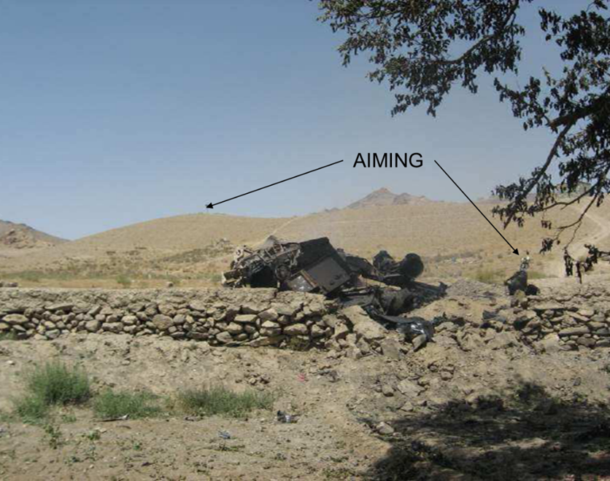
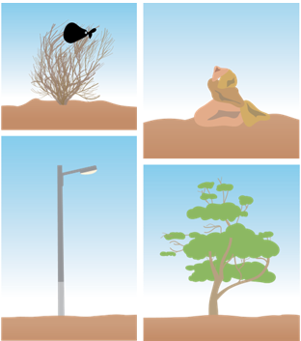
Personal Threat Assessment – Aiming Markers
11
Notes:
An aiming marker is a local feature or artificial item located between a firing point and contact point of a command IED used to optimise the moment of initiation.
Aiming markers are used to assist in aiming and initiating a command IED at the optimal moment.
It’s positioned in front or behind the location of the IED with respect to the location of the firing point.

Slide 12
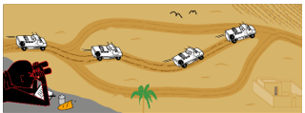
Personal Threat Assessment – Ground
12
Notes:
Does the ground or terrain lend it self to an attack? If you were the adversaryis this the kind of place that you would carry out an attack? Ground can also be used to refer to ground sign.

Slide 13
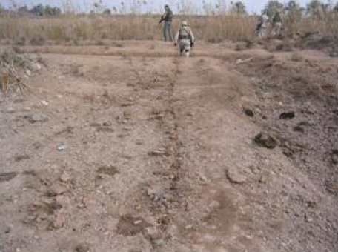
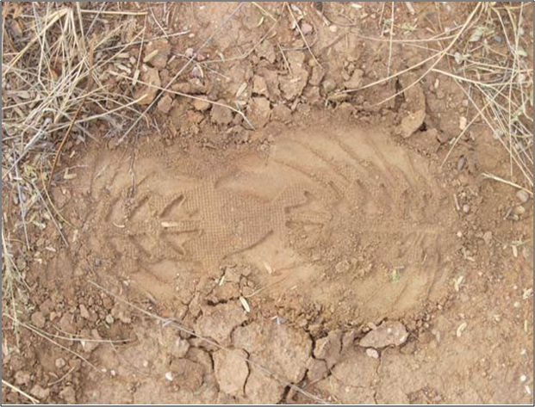
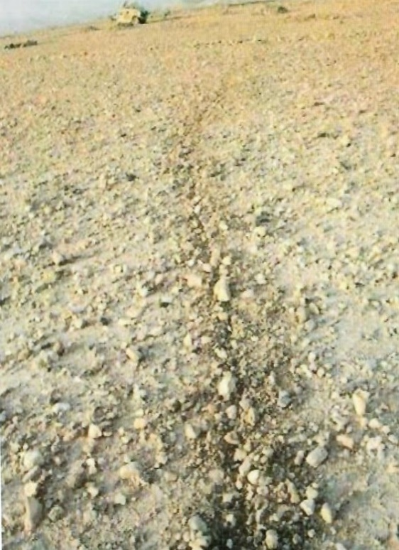
Personal Threat Assessment – Ground
13
Notes:
Ground should also be used as a reminder to look for ground sign.

Slide 14
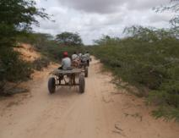
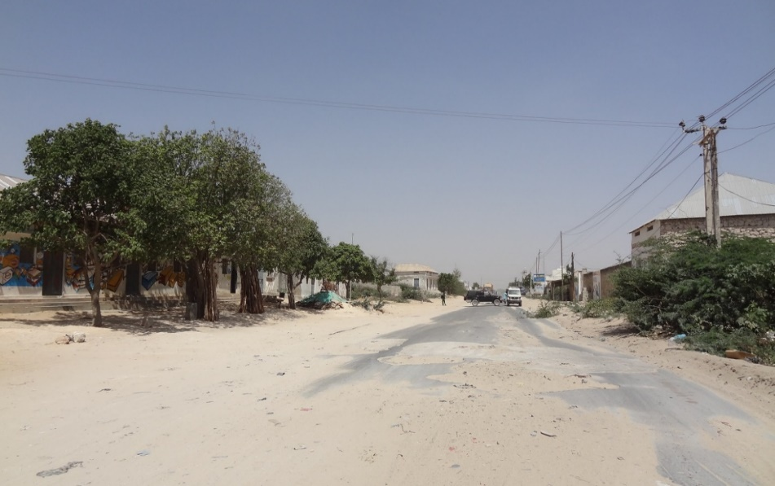
Personal Threat Assessment – Environment
“absence of the normal and presence of the abnormal”
14
Notes:
Environment is also referred as atmospherics. It is a description of the mood or feeling created by awareness of the environment. It’s synonymous with expression “absence of the normal and presence of the abnormal”.
Examples
Presence of fewer people in a locality than normal.
Presence of more people in a locality than normal.
People acting suspiciously or paying undue attention.
Lack of traffic when it would normally be present.
Sequence of persons, possibly spotters, using mobile phones while watching security forces.

Slide 15
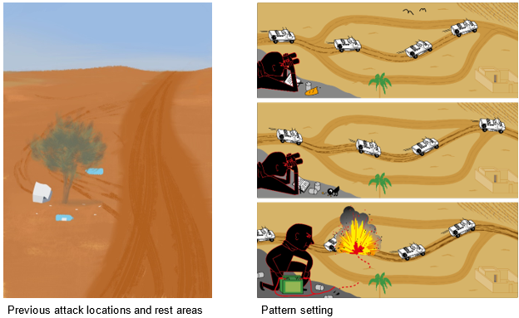
Personal Threat Assessment – Setting Patterns
15
Notes:
Setting Patterns. Have you or your team been setting patterns? Have you used this route before? Have you been conducting activities at the same time every day? If you have set a pattern, you could be targeted. Two very common examples of pattern setting include using the same routes while patrolling or stopping on patrol in the same locations. In the majority of IED strikes, there has been some kind of targetable pattern that has been set by friendly forces.

Slide 16
Personal Threat Assessment
Treat this like a drill.
Systematically ask yourself if you can see any of these indicators on patrol
If you suspect something, make it known to your patrol commander
Channelling
Aiming Markers
Ground (Terrain)
Environment
Setting Patterns
16
Notes:
CAGES should be used like a drill. Ask yourself systematically if any of the conditions of CAGES are met. If they are, you are almost certainly approaching a VP. This should trigger you to be on the look out for GSA. If you have identified that you are approaching a VP you should alert your patrol commander.

Slide 17
2.4.3 Types of VPs and VAs

Slide 18
Aggressor Opportunity
VP’s and VA’s
Terrain Oriented VA/VP
A terrain orientated VP/VA is where the ground offers a particular advantage
Situationally Oriented VA/VP
An adversary may use friendly forces patterns or predictable actions/responses to mount an attack at a specific point. It may be difficult to fully understand the adversary’s intent during planning; where this is the case, Advanced Search assets should be tasked or advice sought from a Search Advisor.
Notes:
It is important to note the VA’s and VPs may be further categorized as Terrain or Situationally oriented VA/VPs. This is to say that VA/VPs may be determined both by the physical terrain or by or actions. The definitions of both are:

Slide 19
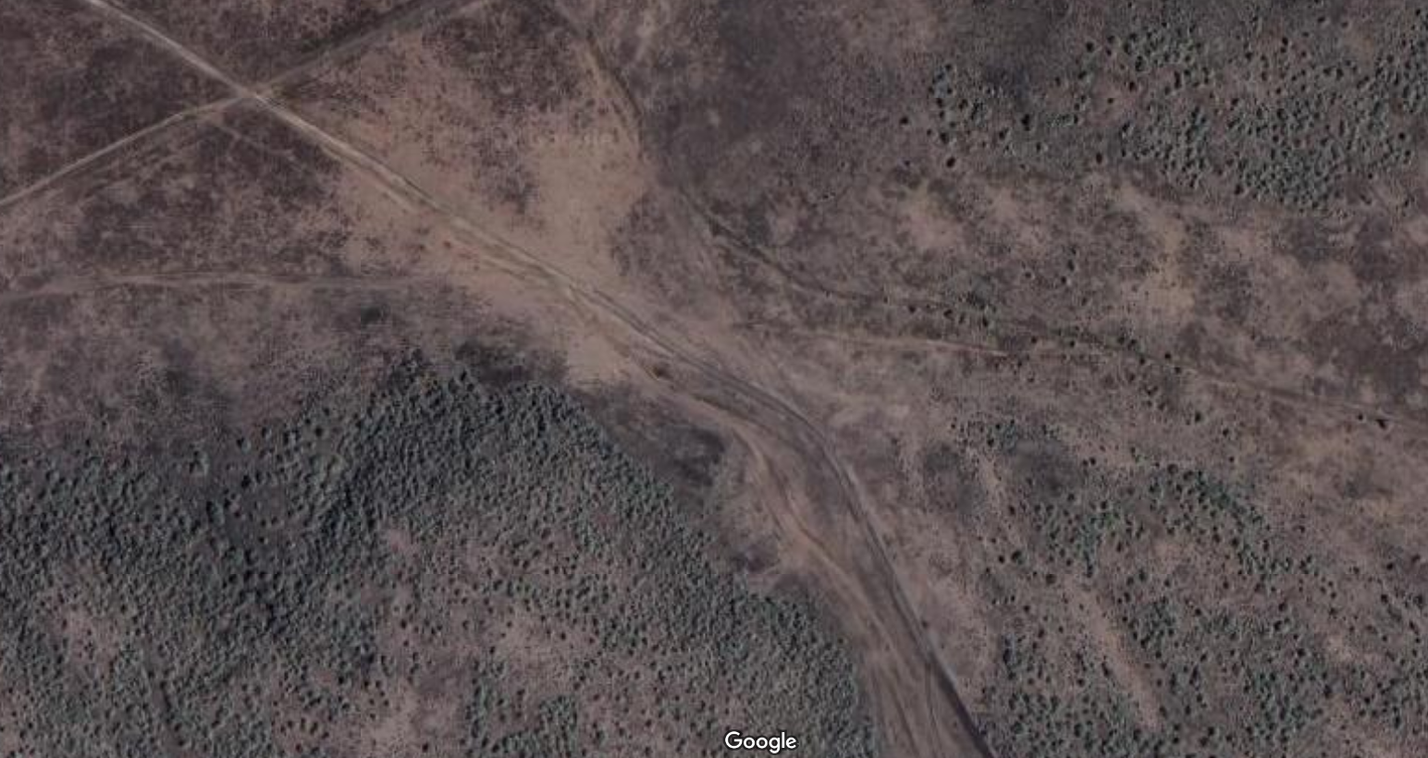
Aggressor Opportunity
Terrain Oriented
Notes:
This is an example of a Terrain Oriented VP. Instructor Notes: Build the slide describing the hashed areas as restrictive terrain. This leaves a specific area which is channeled that would be classed as a VP. It is a VP because the terrain has forced us to be channeled.

Slide 20
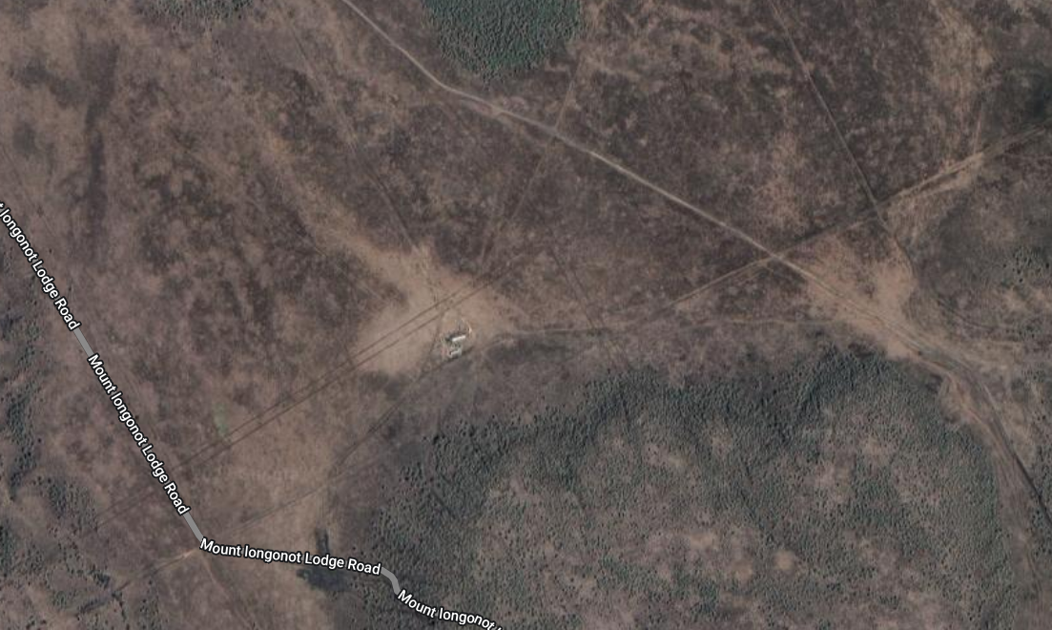
Aggressor Opportunity
Situationally Oriented
Patrol sets up VCP here everyday
Notes:
Red line is an example of a patrol route. The patrol goes out at the same time every day, follows the same route and sets up a VCP at the same place everyday. This route is now a situational VA and the checkpoint is a situational VP.

Slide 21
2.4.4 Examples of VPs and VAs

Slide 22
Examples of VPs
Vulnerable Points
Obvious road junctions or bends in roads
High banked roads, culverts or bridges
Choke points
River, stream or Wadi crossings
Previous patrol routes.
Previous and likely ICP locations and cordon positions
Frequently used/obvious approaches to SF base locations
Potholes or other known obstructions on roads, tracks or paths
Notes:
When deciding where to place an IED to target you, the Aggressor will consider the location where he thinks he will have the greatest chance of success. Points where your movement is forced to slow down or is channeled by the environment will increase the Aggressor's chance of success and therefore it is more likely that you will be targeted in these locations.
When identifying where you might be targeted (VPs) consider the following;
Obvious road junctions or bends in roads – i.e. obvious slow down points.
High banked roads, culverts or bridges.
All evident channels/choke points, e.g. alleyways, cul-de-sacs, routes flanked by walls, buildings or water etc.
River, stream or Wadi crossings.
Previous patrol routes. (Check honesty traces).
Previous and likely future ICP locations and cordon positions.
Frequently used/obvious approaches to SF base locations.
Potholes or other known obstructions on roads, tracks or paths.

Slide 23
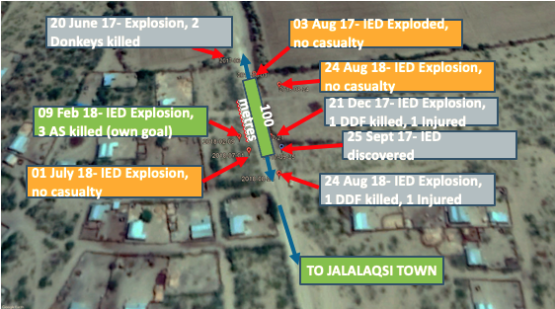
Examples of VPs
Vulnerable Points – Previous Attack Sites
23
Notes:
A previous IED attack at a particular location is evidence that all necessary conditions were present at that time. This is why aggressors may have chosen and continue to use them.
When a number of IED attacks occur at the same location, they are often referred to as “IED Hotspots”.
The analysis tool of heat mapping using different colours to visually depict areas of higher IED activity in an area of consideration is very useful.

Slide 24
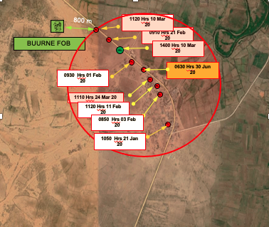
Examples of VPs
Vulnerable Points – Approach to friendly force locations
24
Notes:
Whenever a base location is established, it is necessary for logistical resupplies and operational deployment to enter and exit the base.
There are limited number of approaches to a base.
Aggressor can emplace an IED on these approaches as they are routes of canalization.
Increasing the number of approaches and entry points a base has and if their use is varied randomly, the vulnerability of such approaches can be reduced,
However, additional security requirements as an increased number of entry points require additional assets to protect them from attack.

Slide 25
Examples of VPs
Vulnerable Points – Previously occupied locations
No | Year | Incident in Host Nation FOB | IED
1 | 2017 | 25 June, conduct a pre-dawn attack and briefly occupies the FOB
2 | 2018 | 7 June, conduct a pre-dawn attack and briefly occupies the FOB | YES
3 | 2018 | 25 August, conduct a pre-dawn attack and briefly occupies the FOB
4 | 2018 | 15 October, conduct a pre-dawn attack and briefly occupies the FOB | YES
5 | 2018 | 1 December, Host Nation vacate the FOB due to political issues allowing to occupy the position
6 | 2019 | 17 August, conduct a pre-dawn attack and briefly occupies the FOB
7 | 2020 | 25 March, conduct a pre-dawn attack and briefly occupies the FOB | YES
8 | 2020 | 5 August, conduct a pre-dawn attack and briefly occupies the FOB | YES
25
Notes:
Not all positions used by security force personnel are manned continually and are abandoned for periods of time and then reoccupied, e.g.
Defensive positions out from a main base location that is only manned at certain times e.g. first light and last light
Check Point (CP) only occupied for periods of high security e.g. Vehicle Check Point (VCP) at key urban points.
A previously occupied position is abandoned due to aggressor action and later retaken. It is common practice to boobytrap such positions by retreating forces i.e. emplace IEDs.
You can see from the table an example where friendly forces continue to re-occupy a disused FOB. Note the number of IED incidents.

Slide 26
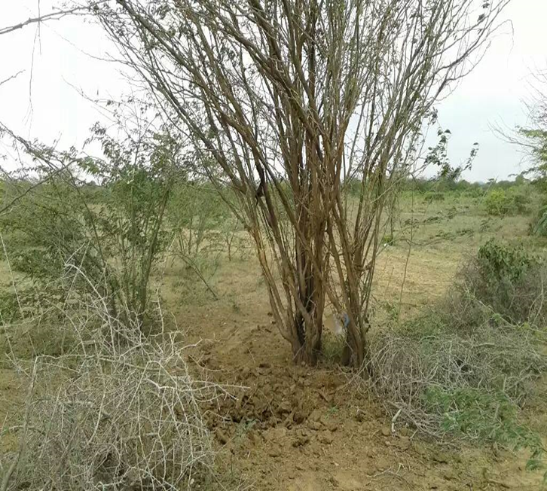
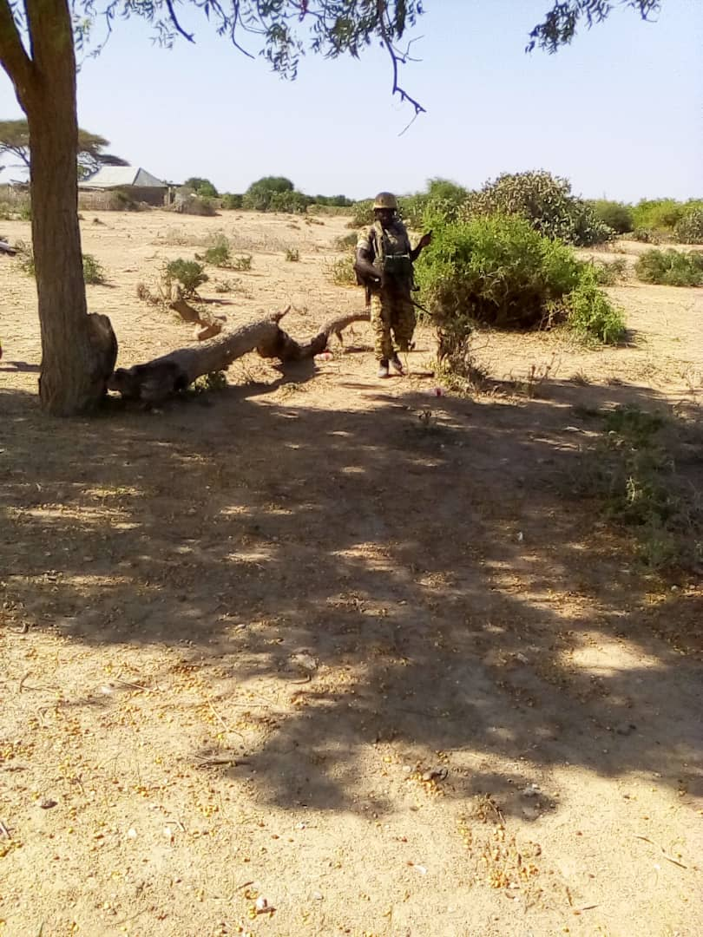
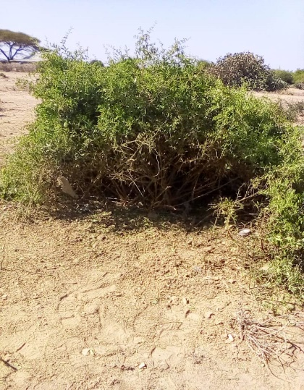
Examples of VPs
Vulnerable Points – Previously occupied locations
Example of two previously occupied check points, both of which with VO IEDs, to target returning troops
26

Slide 27
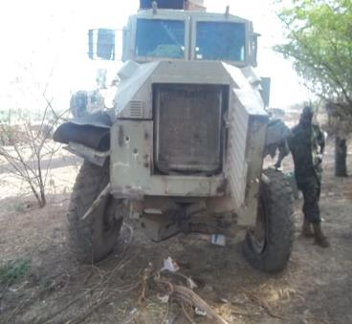
Examples of VPs
Vulnerable Points – Culverts
27
Notes:
Culverts are an example of a VP as they force us to slow down and become canalized.

Slide 28
Examples of VPs
Vulnerable Points – Bridges
Songobia Bridge, Mali
28
Notes:
Bridges are build across rivers because surrounding area is impassable. River crossing points and bridges over rivers, wadis, ditches and valleys force those using them to use pre-defined routes i.e. canalised routes.
At crossing points where there is no solid surface such as non-bridged wadi, stream and river crossing points the surface will be soft making emplacement easier and possibly the wetness allow for lower ground signs of IED emplacement.
Stream beds are good to emplace IEDs in low water or rocky areas.

Slide 29
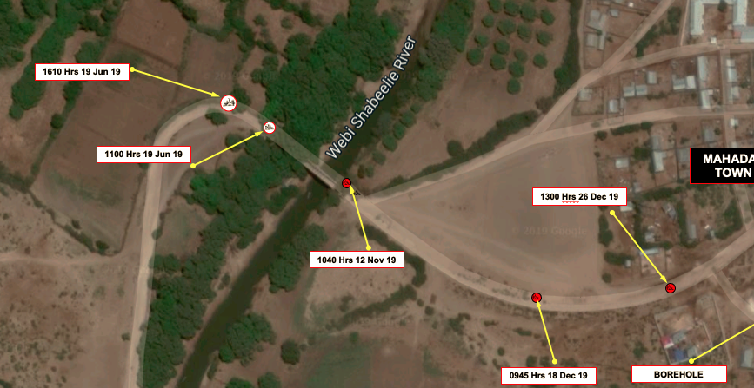
Examples of VPs
Vulnerable Points – Bridges
29
Notes:
This slide shows an example of a bridge across a river. You can see from the incidents the number of times it was targeted by IEDs. This also is an example of sharp bends, see later slide.

Slide 30
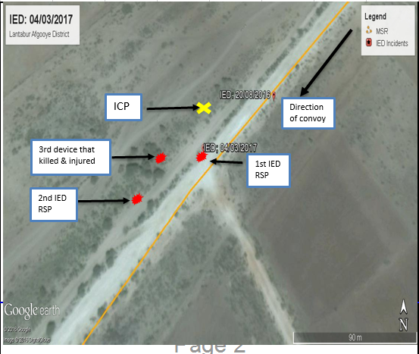
Examples of VPs
Vulnerable Points – Intersections and Junctions
30
Notes:
Intersections and junctions are points on a route at which vehicles are forced to slow down or stop due to traffic or to avoid an accident.
Such VP offer an aggressor
Slow moving or static target
Compacted targets
Predictable target actions at this location

Slide 31
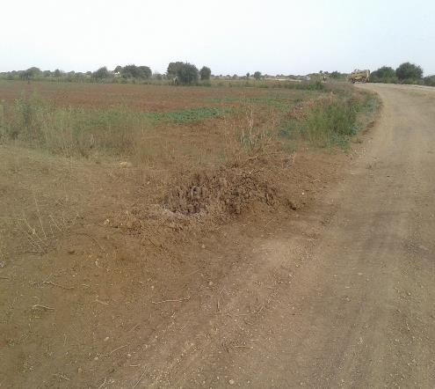
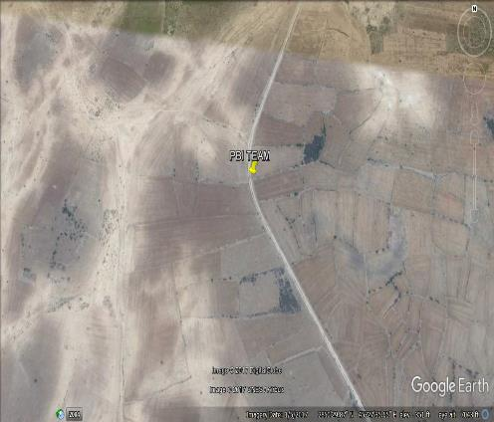
Examples of VPs
Vulnerable Points – Sharp Turns
31
Notes:
Sharp turns on routes are points where vehicles are forced to slow down to avoid coming off the road or turning the vehicle over, making target engagement easier for an aggressor.

Slide 32
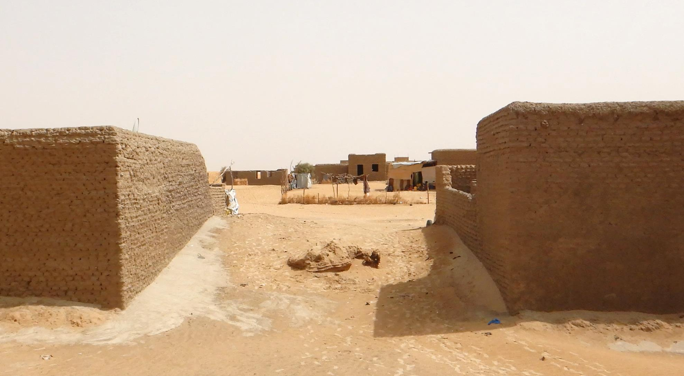
Examples of VPs
Vulnerable Points – Choke Points
32
IED on a choke point in Timbuktu Mali
Notes:
Choke points are locations in which the terrain or an obstacle does not allow the free movement through it and requires the use of pre-defined route i.e. they are points of canalisation which an aggressor can exploit.
Movement being restricted to a specific route through man made or natural obstacles in your way.
Examples of areas of canalisation include:
Rocks, fallen trees or broken down vehicles on the route
The entry / exit to a valley or pass
A gap in a wall

Slide 33
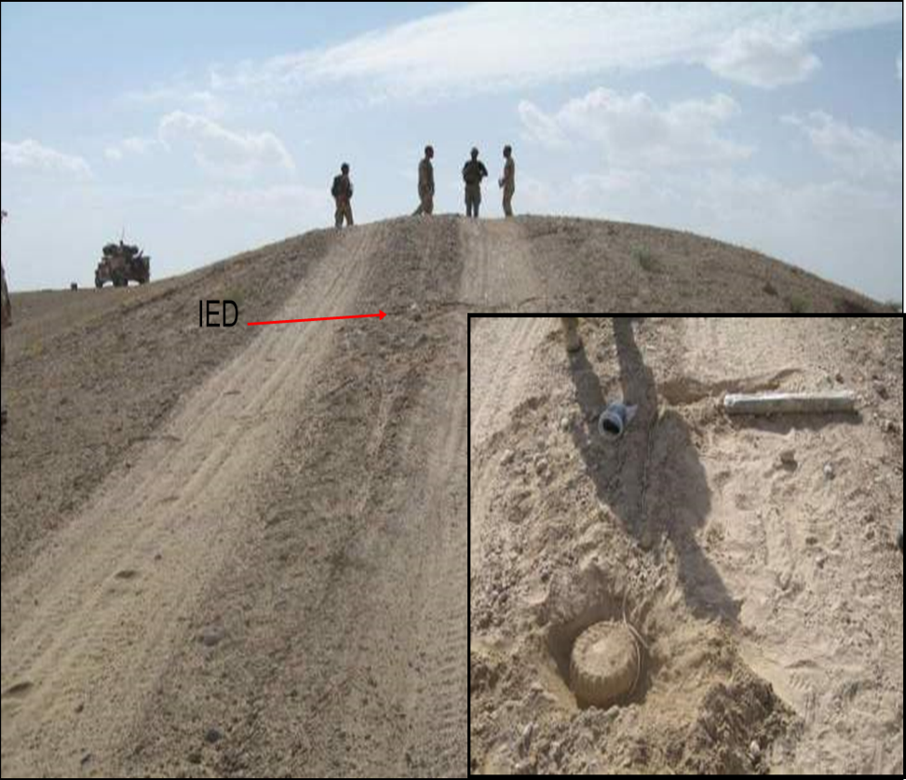
Examples of VPs
Vulnerable Points – Steep Slopes/Crest of Hill
33
Notes:
Steep slopes can be a VP due to the need of a vehicle, particularly travelling up hill to need to slow down. Similarly, the crest of hills with a steep slope, often means that as a vehicle crests the hill, the road cannot be seen due to the front of the vehicle obscuring the road. This means it is hard to spot GSA.

Slide 34
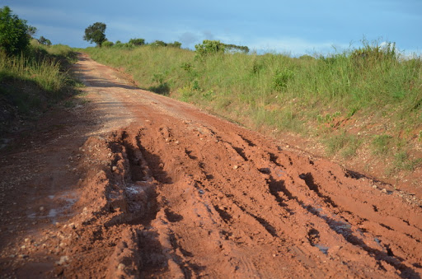
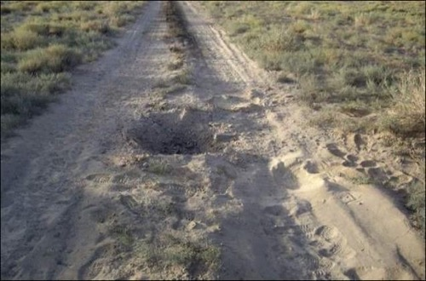
Examples of VPs
Vulnerable Points – Areas of soft ground or pot holes
Soft Ground can prove advantageous to the Insurgent:
It is easier to emplace devices in soft ground.
Vehicles are forced to slow down.
Vehicles can become stuck.
Troops may have to dismount vehicle to help with recovery if they become stuck.
Notes:
Soft Ground
Soft ground can prove advantageous to the adversary:
It is easier to emplace devices in soft ground,
Vehicles are forced to slow down,
Vehicles can become stuck,
Troops may have to dismount vehicle to help with recovery if they do get stuck.

Slide 35
Examples of VAs
Vulnerable Areas
Common characteristics of vulnerable areas include (mnemonic POLICE THESE):
● Previously used tracks & patrol routes
● Often used positions
● Linear features
● Interior of buildings
● Canalized routes
● Extended long stretches of road
● Tactically important areas
● High ground dominated areas
● Escape routes into and out of areas
● Successive VPs in close proximity
● Exit or entry of areas of urban / rural interfaces;
Notes:
Common characteristics of vulnerable areas include (mnemonic POLICE THESE):
Previously used tracks & patrol routes
Often used positions
Linear features
Interior of buildings
Canalized routes
Extended long stretches of road
Tactically important areas
High ground dominated areas
Escape routes into and out of areas
Successive VPs in close proximity
Exit or entry of areas of urban / rural interfaces;

Slide 36
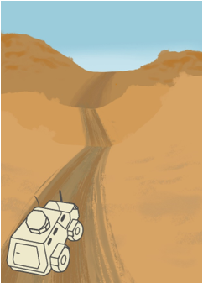
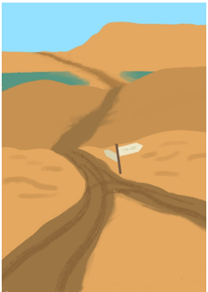
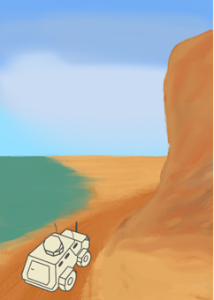
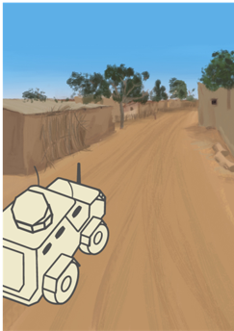
Examples of VAs
Vulnerable Areas – Examples
Long sections of channeled terrain
A series of VPs close together
Terrain dominated by high ground
Urban rural interface
Notes:
These are examples of VAs.
Long Sections of Channeled terrain force our travel to become predictable.
A series of VPs which a close together can be considered as a single VA.
Terrain dominated by high ground which affords the adversary an advantage of attack.
The rural urban interface is a classic VA as it allows the adversary to have freedom of movement in the urban terrain whist our movement into the urban area is predictable.

Slide 37
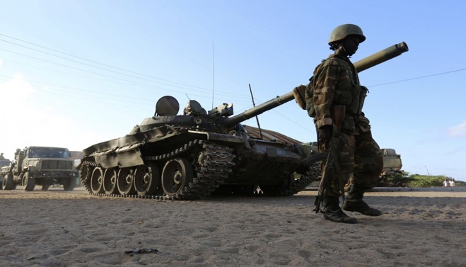
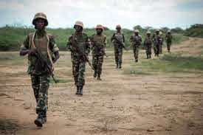
Examples of VAs
Previously Used Tracks and Patrol Routes
Tracks used by previous Patrols provide a good indicator of future patrol routes. Pattern setting allows Troops to be targeted.
If you are on a route that has been used before or regularly used, you are vulnerable to attack
Notes:
Previously Used Tracks and Patrol Routes
It is important to know and track previous patrol routes to enable you to understand where you are likely to be targeted. Inevitably there will be tracks which have to be used repeatedly due to being the only route available.

Slide 38
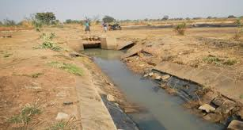
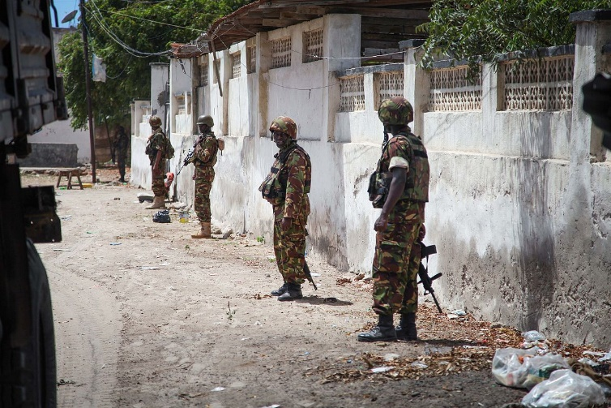
Examples of VAs
Linear Features
Provide the Insurgent with:
Easy concealment of Command Wires
Line of Sight between Firing Point and Contact Point
Provide troops with:
Shade from the heat
Cover from view and/or fire
Examples include:
Compound walls
Irrigation ditches
Edges of fields
Wadis
Notes:
Linear Features
Provide the adversary with:
Easy concealment of command wires,
Line of sight between firing point and contact point.
Provide troops with:
Shade from the heat,
Cover from fire and/or fire.
Examples include:
Compound walls,
Irrigation ditches,
Edges of fields,
Wadis

Slide 39
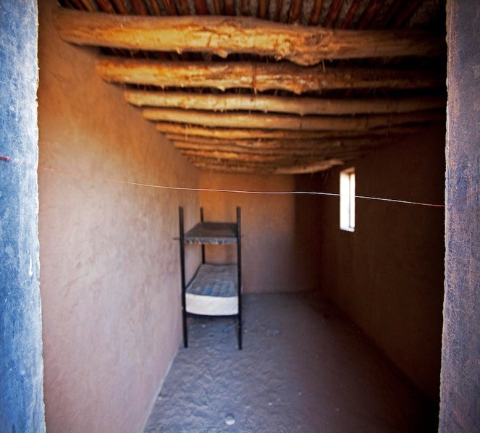
Examples of VAs
Linear Features
Interiors of buildings can easily conceal enemy presence as well as offering opportunity for channelling through doorways in which devices may be hidden.
Notes:
Interiors of Buildings
These provide multiple opportunity for friendly forces to be channelled, which can be taken advantage of. Perpetrators can also conceal themselves from the view of personnel more easily.

Slide 40
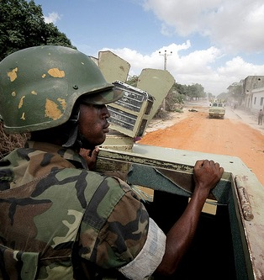
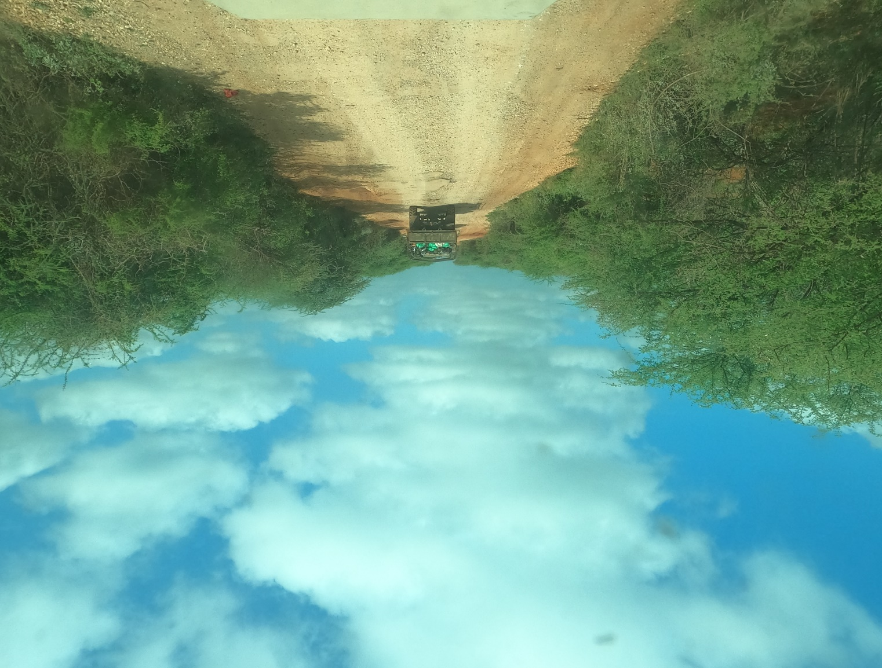
Examples of VAs
Canalized Routes
Canalized routes are areas where patrols are channelled by natural or man-made features such as:
Banks, ditches.
Gaps between dense vegetation.
The base of steep terrain.
Notes:
Canalized Routes
In addition to having movement options restricted, canalised routes can also reduce visibility making it harder to observe for aggressor approaches, patterns of life, aiming markers etc.

Slide 41
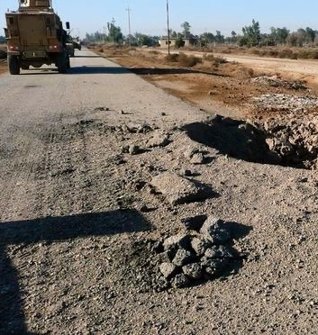
Examples of VAs
Extended Stretches of Observable Road
Where insurgents can see Friendly Forces approach from a distance.
This type of terrain increases potential for CWIED and RCIED threats.
Notes:
Extended Long Stretches of Road
Perpetrators are able to observe troops movement well in advance and anticipate numbers, capability etc. It also provides line of sight (LoS) and is advantageous for the use of CW and RC IEDs.

Slide 42
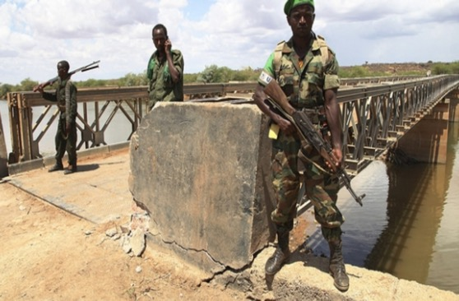
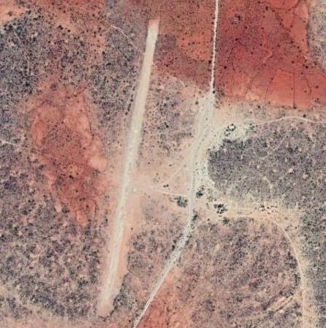
Examples of VAs
Areas of Tactical Importance
Areas that are tactically important to troops may become a target so that the Insurgent causes disruption to future operations, they include:
Airfields, Runways and HLSs.
Communication masts.
Water re supply points.
Fuel re-supply points.
Crossing Points.
Notes:
Tactically Important Areas
Any location that is necessary for friendly forces or is vital for mission success should be considered tactically important. Frequently targeted Tactically Important Areas may include: water points, air strips, MSRs, etc.

Slide 43
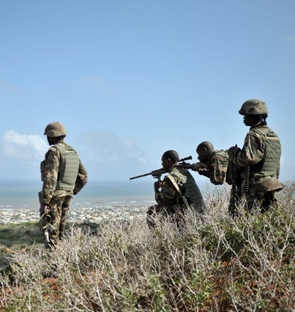
Examples of VAs
High Ground Dominated Areas
High ground-dominated areas provide any of the following:
Good field of view of approaching targets.
Clear line of sight to a contact point and aiming marker.
Unobstructed signal from firing point to the receiver of a RCIED.
Notes:
High Ground Dominated Areas
Good field of view of approaching targets.
Clear line of sight to a contact point & aiming marker.
Unobstructed signal from firing point to the receiver of a RCIED.
These provide good fields of view of approaching targets and can easily be utilised in conjunction with RC and CW IEDs.

Slide 44
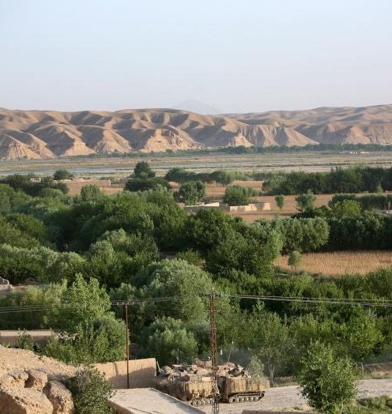
Examples of VAs
Escape Routes
Escape routes may be littered with IEDs to protect perpetrators withdrawal.
They can also conceal routes of approach/exit for other potential attacks.
Notes:
Escape Routes in and out of Areas
Certain pre-determined escape routes from aggressor firing points are likely to have VO IEDs placed around them so as to target possible pursuers in the event of them being identified. Routes may also provide concealed movement which could be used to enhance success of SALW attacks.

Slide 45
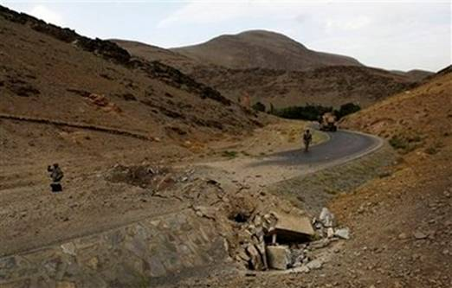
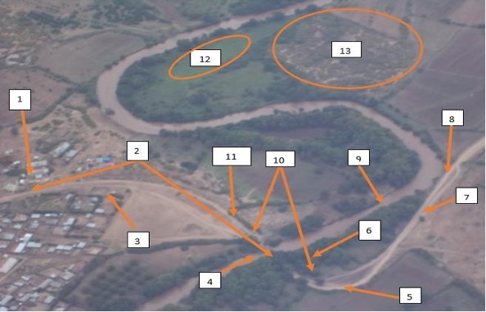
Examples of VAs
Successive VPs in Close Proximity
A number of VPs in close proximity which can not be treated separately are treated as a VA.
Notes:
Successive VPs in Close Proximity
If they are too close to be treated as individual VPs, they will be combined to be considered a VA.

Slide 46
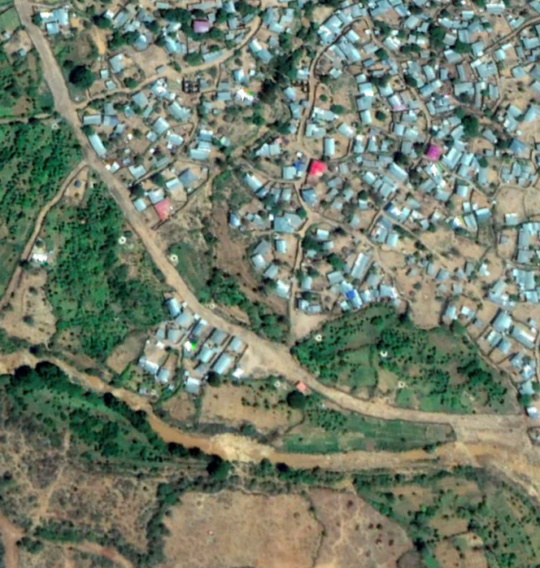
Examples of VAs
Exit Routes of Rural Urban Interface
When changing from urban/rural environments, formations will be changed which takes time to execute and creates vulnerabilities.
Notes:
Exit Routes of Urban/Rural Interface
As personnel move from urban to rural surroundings or vice-versa, it will take time to change formations as per desired TTPs. This means being stationary and vulnerable for a time whilst troops are moving into new positions/formations. It will also require different considerations in terms of likely firing points, contact points, visibility etc.

Slide 47
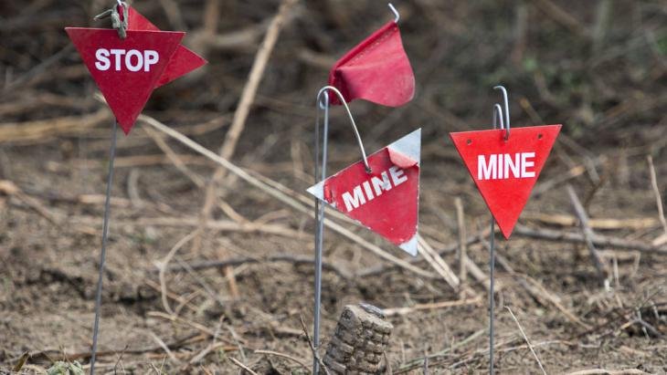

Questions?

